Slide 1
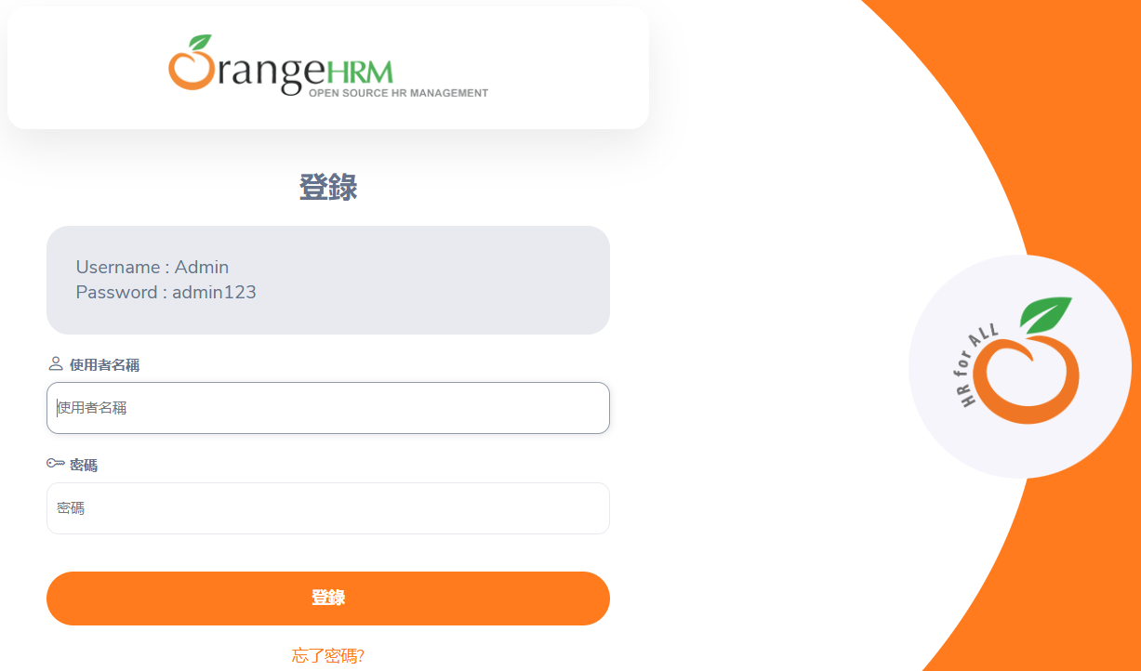
Software Testing
Zain Ali Siddiqui - 21K-4870
Saim Javed - 20K-0424
Xabad - 21K-4612
Mirza Uzair - 21K-3922

Slide 2
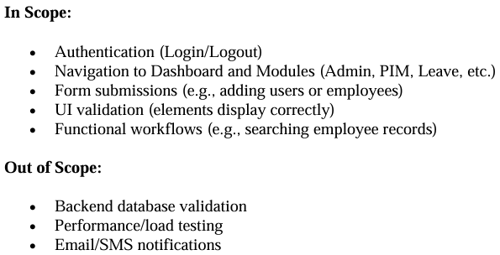
Scope Of Testing

Slide 3
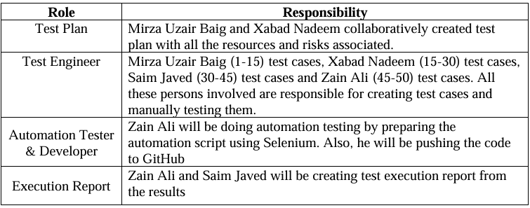
Roles & Responsibilities

Slide 4
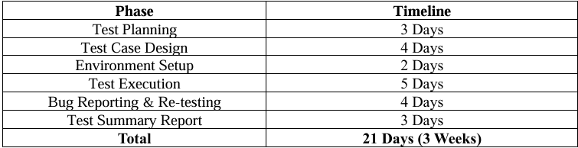
Test Schedule

Slide 5
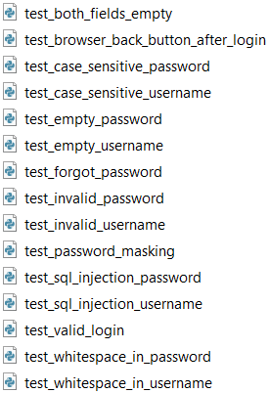
Automated Test Cases

Slide 6




Tools Used For Automated Testing

Slide 7
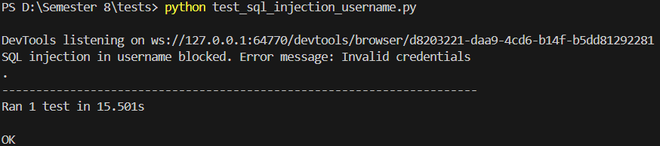
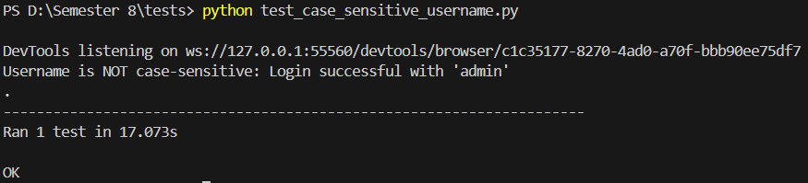
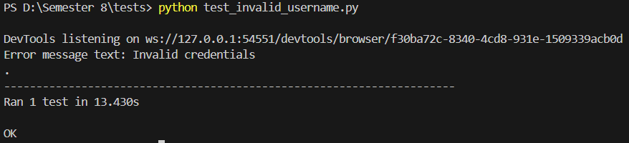
Automated Test Cases Output Samples

Slide 8
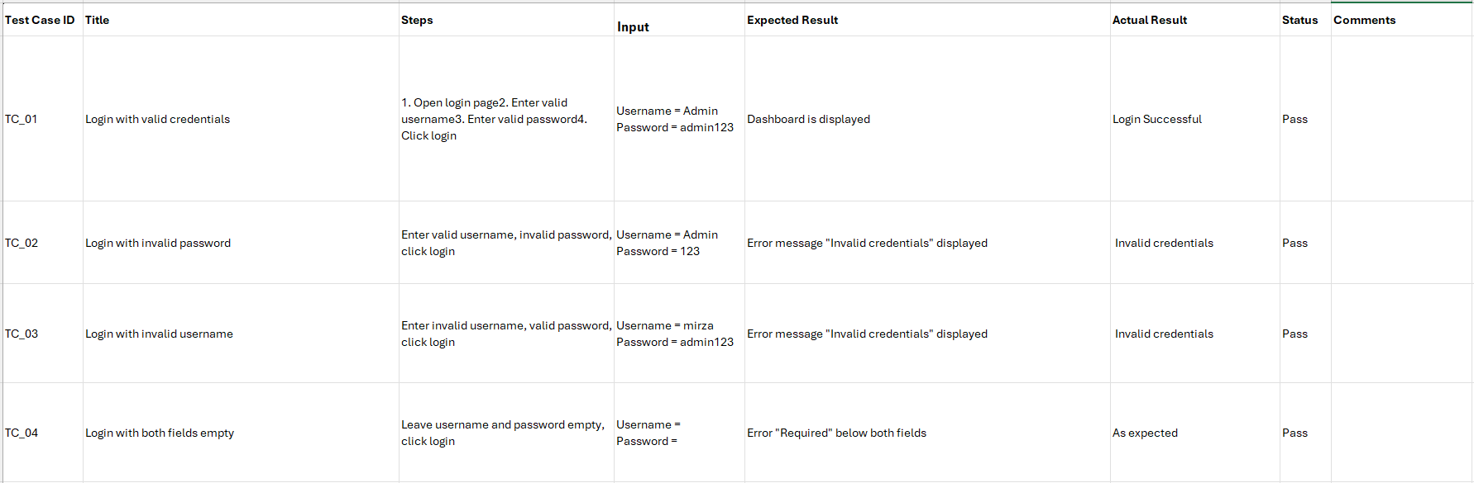
Manual Test Case Samples

Slide 9
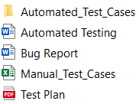
Final Submission

